Slide 1

Science Escape Teacher Directions
There are several ways to play the science escape games in the classroom. You will need to decide which approach to take before setting up the first game.
Envelopes and Codes - The first method is the cheapest way but still provides a great escape room experience. I’m going to describe the experience for one group, but you will want to break the class up into many teams.
You will decide which puzzles you will use for the game and put each puzzle into a separate manila envelope. After playing the video challenge, you will give the group their first challenge.
The remaining puzzles will stay in an area of the room where the students can check them in and out.
There are two ways you can check the codes. The first method is that the students will write the code down on the provided answer sheet and you will check it against the answer key.
The second method involves using digital locks using Google Forms. A detailed description of this method is listed on next page.
Once the students solve all of the puzzles presented to them, they will open the last envelope or box that contains their prize.
Locks and Boxes – Using locks and boxes is a more immersive experience for the students, but it is the more expensive option because you will need some equipment.
One suggestion is to use one box, a lockout hasp, and several locks per group (suggestion on following page). The lockout hasp will save you from having to buy multiple boxes per group.
The game can still be played with envelopes, but after each puzzle the group gets to open one of the locks rather than write their answer on paper or enter the lock digitally.
There are many variations for escape rooms. Pick a method and run with it.

Slide 2
Science Escape Teacher Directions
Digital Lock Directions:
If the school is 1:1, or you would like to use the digital locks, please access the Google form below.
http://bit.ly/Back2SchoolEscape
This form will be copied to your Google drive and can be edited to fit the needs of your classroom. I’ve created a tutorial on how to edit the digital locks Google form.
https://www.youtube.com/watch?v=nQhTFeOfMQc&t=228s
Materials per Group:
All printed materials from the puzzles chosen
Manila envelopes (used for each of the puzzles)
Clue One: clipboard and small binder clips
Clue Three: FriXion brand pen in blue, hairdryer to disappear the ink
Clue Six: Long thin box or wrapping paper tube, string, magnet, and paper clip.
If you want to use a box and locks instead of envelopes, see suggestions below.
Lockout Hasp - example http://amzn.to/2CgRvaV
Four, 3-digit locks – example https://amzn.to/2ZtH6oR
One, 4-digit locks - example http://amzn.to/2G8ObRG (3 pack)
One, Storage box with place for the lockout hasp – example http://amzn.to/2ChxlO0
Have you found a better or cheaper solution? Let me know at chris@keslerscience.com

Slide 3
Science Escape Teacher Directions
Teacher Notes and Tips:
Editable templates have been created as separate slides for you to modify. If you edit the clues, you may also need to edit the answers in the Google Answer form or on the student answer sheet.
There are 8 puzzles with each science escape. However, they are all independent of each other so you can remove puzzles to ensure there is enough time for some groups.
The puzzles can be given in any order. They are not dependent on each other.
I would encourage you to do the puzzles before giving them to the students. This will help you become a more effective moderator when it comes to game day.
Locks and a bunch of equipment are not needed to run this escape game. Instead, you can use envelopes and give the students the next one as they show their correct answers for each puzzle.
You will choose between the student answer document or the digital lock document (instructions on page 2) to verify the codes.
Making student groups of 4 or fewer keeps everyone engaged better.
For a 40-minute class period, you will probably only use 5-6 total puzzles. If the class is longer, the students may be able to complete all 8.
It’s okay if some groups don’t finish. In fact, you don’t want all groups to finish. A typical commercial escape room has about 15-30% escape rate. It’s an accomplishment to escape!
Be prepared to provide subtle hints to groups who are struggling. If a group has been working for 7 – 10 minutes on a puzzle, give them a hand so they can feel some progression within the game.
The challenge video is in a separate folder with your download. Show it at the beginning of class and start the timer.
Students can use scratch paper or the back of their answer document for math problems, etc.
The introduction video has been included in the download folder.

Slide 4
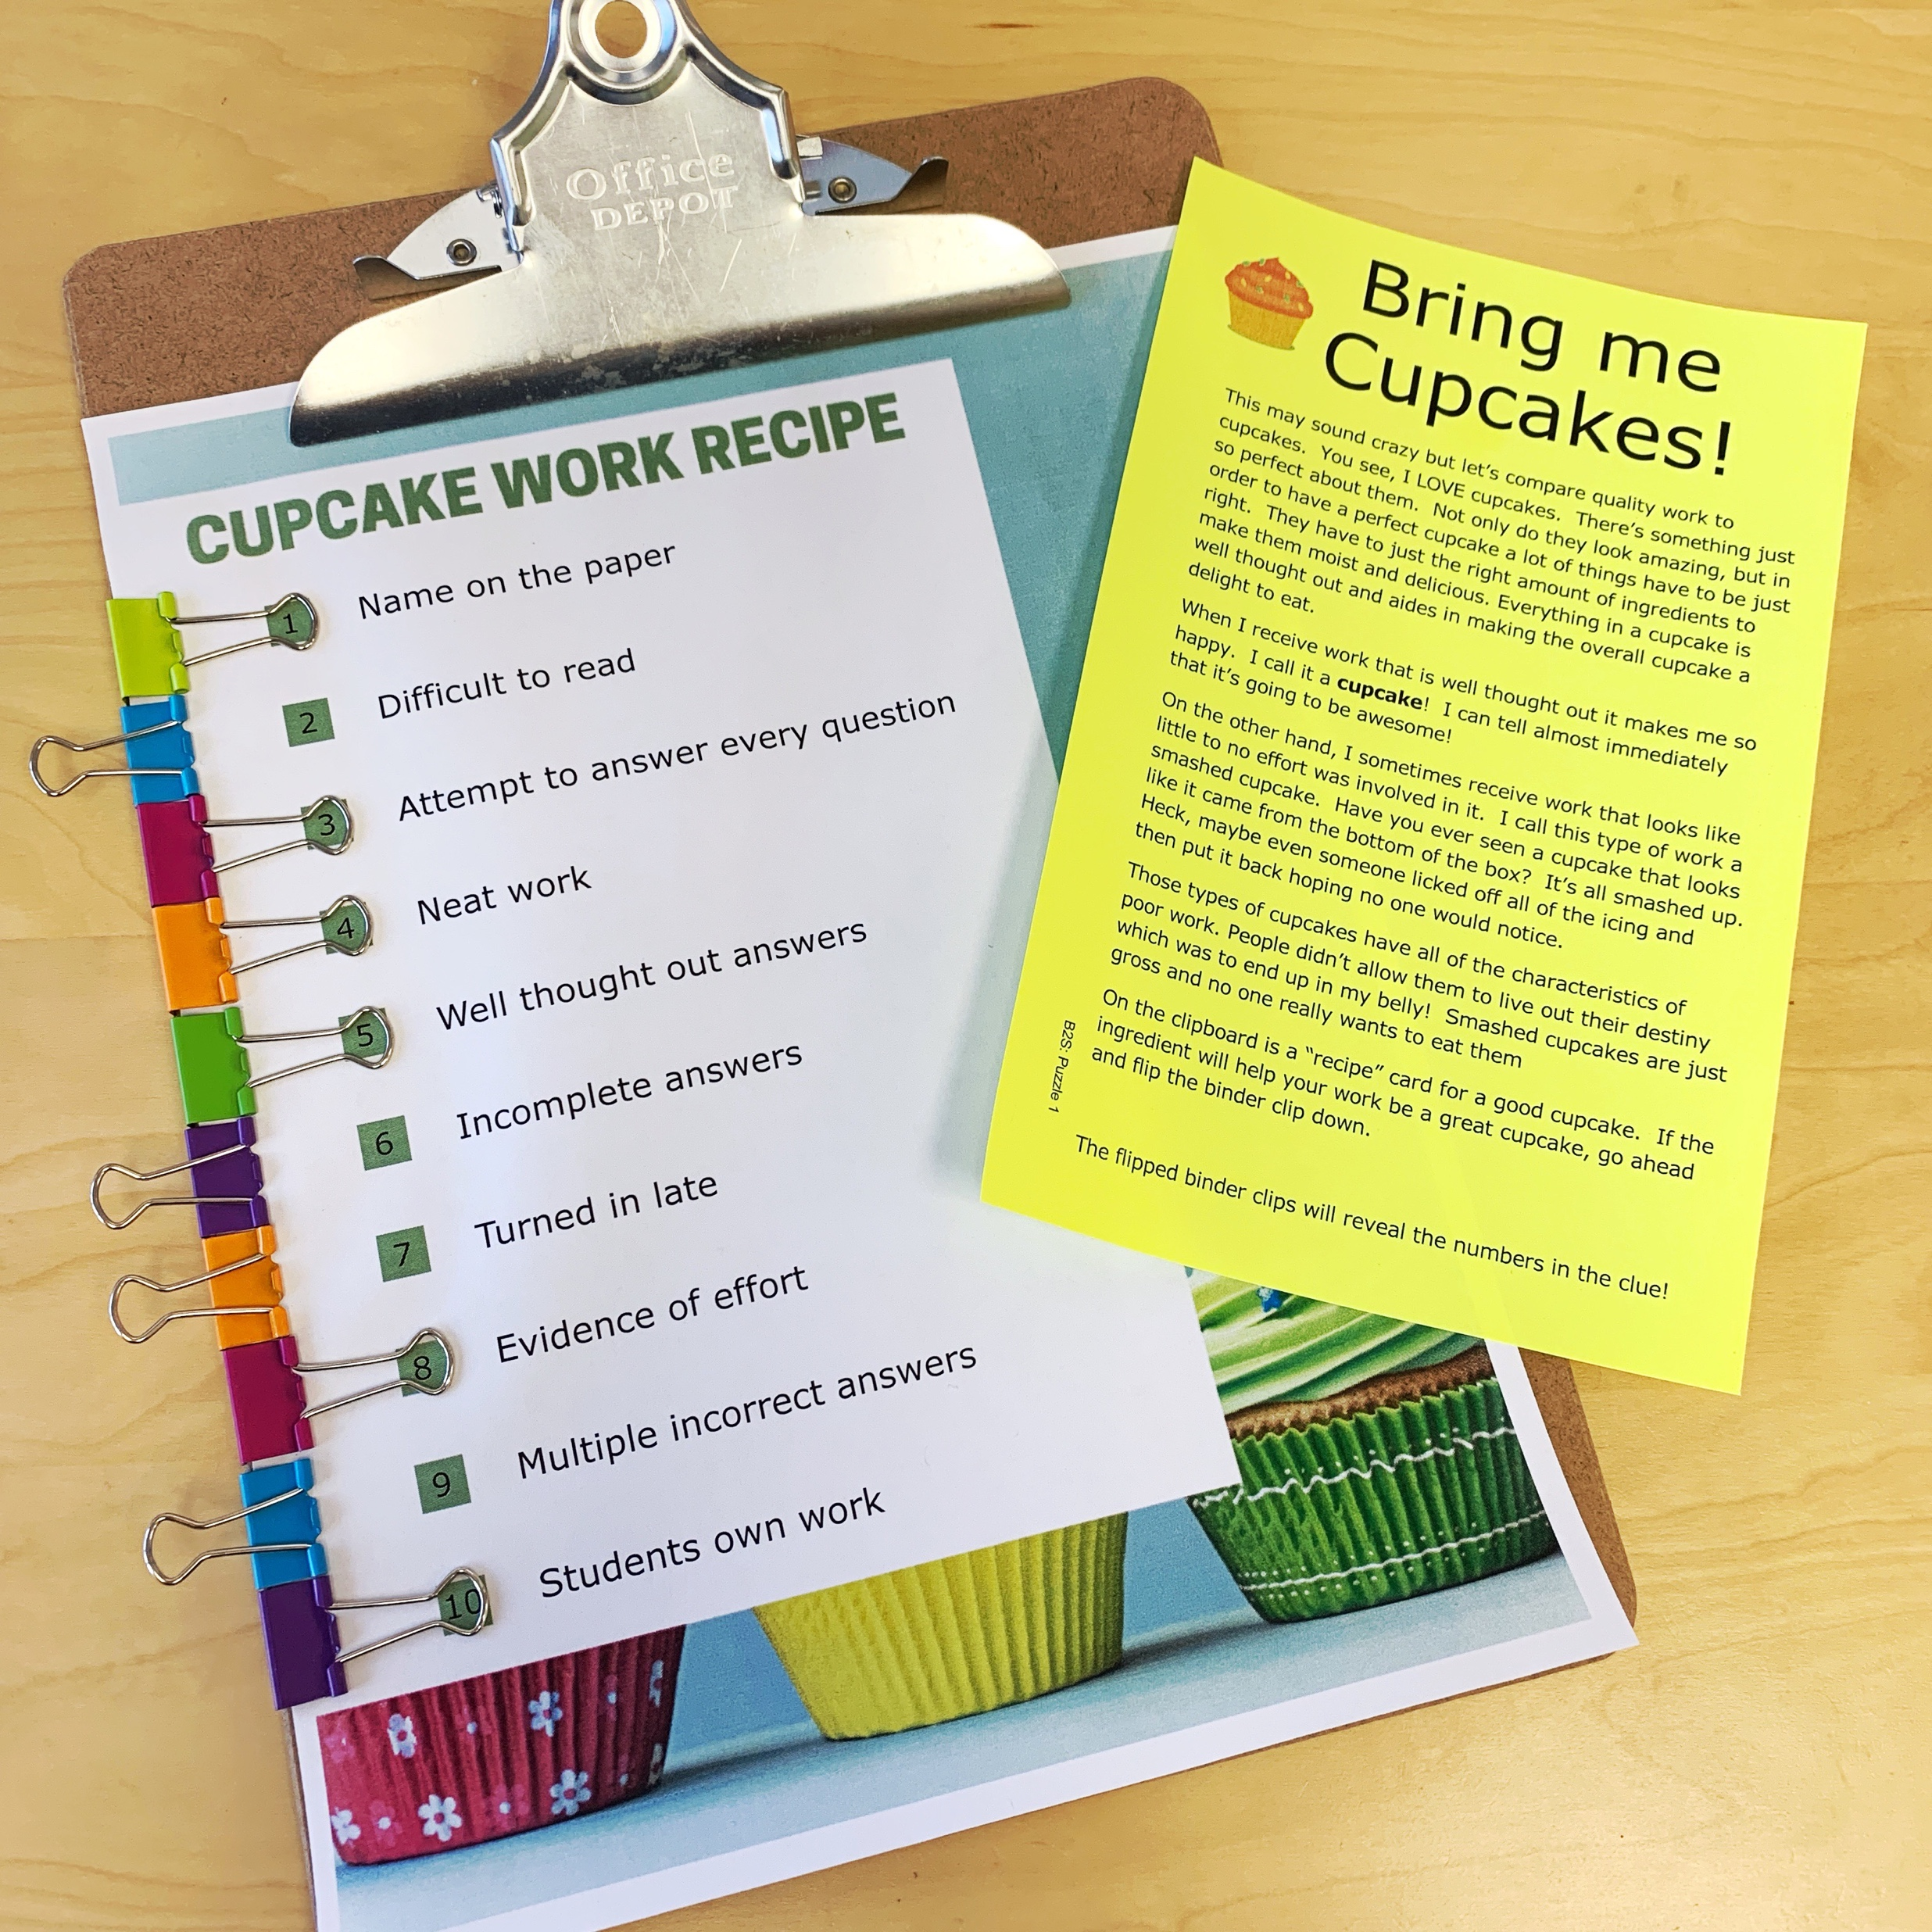
Science Escape Teacher Directions
Puzzle Information:
At this station, students will receive a clipboard with binder clips (see picture at right). If the statement is true, then they should flip the binder-clip over. The numbers that are circled by the clips reveal the clue. A blank template is enclosed for you to customize your own expectations for student work. Code: 1345810
At this station, students will use a cipher to decode locations for a classroom scavenger hunt. There are clue cards to include in each physical location. If you have a classroom webpage or website where the information is found, you could edit the webpage to include the number
code on that for the students to find. You can choose to include any number of locations. The clue is the sum of the numbers for each location. “Where in the classroom is each thing? Add the numbers.” Is the answer to the dancing man code. Code: 199 (if all locations are used)
This puzzle requires that the correct answers to the puzzles match YOUR school’s safety policies. Make sure the correct answers are at the following locations: Page 1 ( Fire Drill ), top position (#9) Page 2 ( Lockdown ), bottom position (#3) Page 3 ( Severe Weather ), middle position (#7 ) At this station, students will reveal a secret code using heat-disappearing pens. A hairdryer works very well for making the pen ink disappear. The message can be re-used by putting it in the freezer for a few minutes. **Note—these pens will disappear with lamination and reappear if you put them in the freezer** The clues are for the emergency procedures and should be edited to reveal the correct procedure for your classroom. To set up the clue, use the blue ink FriXion pen to scribble over all of the numbers in the circles. Students will reveal the correct number with a hairdryer. The rebus puzzle tells them to use the hairdryer to reveal the clue, then use the digit on the right. Code: 937

Slide 5
Science Escape Teacher Directions
Puzzle Information Continued:
At this station, students will do a close reading of your own syllabus and answer questions in short answer form. Students will figure out that they need to read the syllabus by putting a series of popsicle sticks in order based on the shapes in the word “SYLLABUS”. You can choose to check the answers in class before allowing them to move to the next clue or have them turn it in as an exit ticket or in-class assignment. You will need to provide your own syllabus for this clue. Code: ANSWERS WILL VARY—These are short answer questions that will need to be checked by someone in order to move on. For the digital locks, give students the answer once their answers meet your expectations: Code 123456 to get to the next puzzle.
This station emphasizes the importance of following directions. You can use the paper printouts (provided) or actual Tangram Blocks for a more kinesthetic puzzle. I suggest hanging the codes in different areas of the room to keep them from guessing the codes from a single sheet of paper. They will need to match their creation to one of the pictures around the room. Code: 5778
At this station, students will use an overlay to figure out where to get a magnet and a piece of string. I have provided several options, but I like letting them hold it up to the light the best because there is minimal prep work involved. The code will be hidden at the bottom of a tall box or tube that is covered with paper. Cut a hole in the cover that is only large enough for the magnet and clue to fit through. It’s nice to use a box too long and dark to see into. You can also use a taped-off wrapping paper tube or rolled up piece of poster board. Secure the box to the floor so dumping the clue out isn’t an option. From the four clues, they will learn where the items are located to build a device to drop into the box/tube and get the code. Students need to figure out to get the magnet from the teacher, find the string, and tie them together to grab the clue at the bottom of the box. The clue will have a paperclip on it to make it magnetic. Code: 845
This station is about growth mindset and the positive attributes that help a student succeed. There is a wanted poster and several cards with qualities on them. The cards are double sided so that one side has a fixed mindset statement and the other is a growth mindset. Students should select the growth mindset statements and add up the numbers on the faces of the cards to reveal the answer. Code: 47
At this station, students go through a set of mazes and collect school supplies. They will then be asked to count up each item and find the product of those numbers Code: 560

Slide 6
Back to School Combinations/Answers
TEACHER KEY
Puzzle #1: Cupcakes 7-Digit Code 1345810
Puzzle #2: Dancing Man Code 3-Digit Code 199
Puzzle #3: Emergency Procedures 3-Digit Code 937
Puzzle #4: Syllabus Hunt 6-Digit Code 123456
Puzzle #5: Follow Directions 4-Digit Code 5778
Puzzle #6: Teamwork Challenge 3-Digit Code 845
Puzzle #7: Growth Mindset Wanted 2-Digit Code 47
Puzzle #8: Maze Supplies 3-Digit Code 560

Slide 7
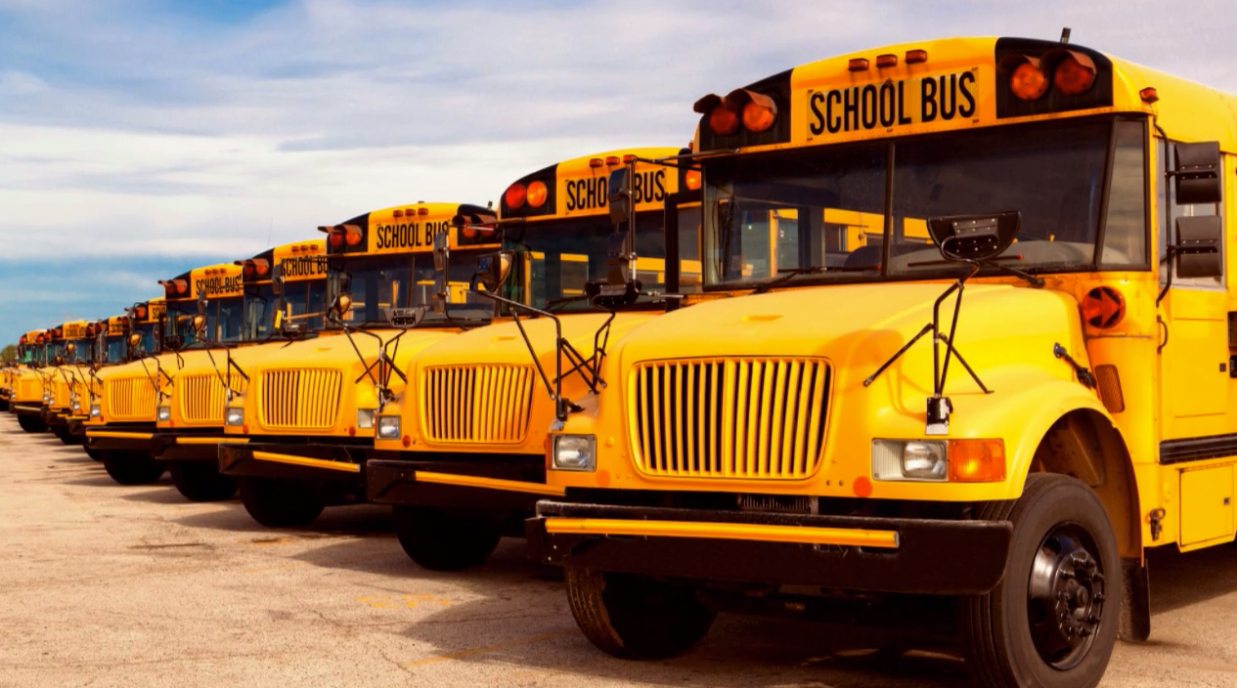
Back to School Science Escape
YOUR CHALLENGE:
Welcome back to school! After a long summer of relaxing, I am sure your brain is eager to get back into gear and solve some puzzles.
During the excitement of the morning, the teacher down the hall has forgotten where she put all of her brand new school supplies. Thankfully, your amazing teacher has set up a series of clues that will reveal the location of the lost school supplies and allow your class to save the day. Can you use teamwork, clues from the syllabus, secrets hidden around the room, and your brains to figure it out before the bell rings?
YouTube Link - https://youtu.be/lL-i5bwC_YM

Slide 8

Back to School Combinations/Answers
Group # ____
Puzzle #1: 7-Digit code ___ ___ ___ ___ ___ ___ ___
Puzzle #2: 3-Digit Code ___ ___ ___
Puzzle #3: 3-Digit Code ___ ___ ___
Puzzle #4: 6-Digit Code ___ ___ ___ ___ ___ ___
Puzzle #5: 4-Digit Code ___ ___ ___ ___
Puzzle #7: 2-Digit Code ___ ___
Puzzle #8: 3-Digit Code ___ ___ ___
Back to School Combinations/Answers
Group # ____
Puzzle #1: 7-Digit code ___ ___ ___ ___ ___ ___ ___
Puzzle #2: 3-Digit Code ___ ___ ___
Puzzle #3: 3-Digit Code ___ ___ ___
Puzzle #4: 6-Digit Code ___ ___ ___ ___ ___ ___
Puzzle #5: 4-Digit Code ___ ___ ___ ___
Puzzle #7: 2-Digit Code ___ ___
Puzzle #8: 3-Digit Code ___ ___ ___

Slide 9

Bring me Cupcakes!
This may sound crazy, but let’s compare quality work to cupcakes. You see, I LOVE cupcakes. There’s something just so perfect about them. Not only do they look amazing, but in order to have a perfect cupcake a lot of things have to be just right. They must have the perfect amount of each ingredient to make them moist and delicious. Everything in a cupcake is well thought out and aides in making the overall cupcake a delight to eat.
When I receive work that is well-thought-out, it makes me so happy. I call it a cupcake! I can tell almost immediately that it’s going to be awesome!
On the other hand, I sometimes receive work that looks like little to no effort was involved in it. I call this type of work a smashed cupcake. Have you ever seen a cupcake that looks like it came from the bottom of the box? It’s all smashed up. Heck, maybe even someone licked off all the icing and then put it back hoping no one would notice.
Those types of cupcakes have all the characteristics of poor work. Smashed cupcakes are just gross and no one really wants to eat them.
On the clipboard is a “recipe” card for a good cupcake. If the ingredient will help your work be a great cupcake, go ahead and flip the binder clip down.
Bring me Cupcakes!
This may sound crazy, but let’s compare quality work to cupcakes. You see, I LOVE cupcakes. There’s something just so perfect about them. Not only do they look amazing, but in order to have a perfect cupcake a lot of things have to be just right. They must have the perfect amount of each ingredient to make them moist and delicious. Everything in a cupcake is well thought out and aides in making the overall cupcake a delight to eat.
When I receive work that is well-thought-out, it makes me so happy. I call it a cupcake! I can tell almost immediately that it’s going to be awesome!
On the other hand, I sometimes receive work that looks like little to no effort was involved in it. I call this type of work a smashed cupcake. Have you ever seen a cupcake that looks like it came from the bottom of the box? It’s all smashed up. Heck, maybe even someone licked off all the icing and then put it back hoping no one would notice.
Those types of cupcakes have all the characteristics of poor work. Smashed cupcakes are just gross and no one really wants to eat them.
On the clipboard is a “recipe” card for a good cupcake. If the ingredient will help your work be a great cupcake, go ahead and flip the binder clip down.
B2S: Puzzle 1
B2S: Puzzle 1

Slide 10

1
Name on the paper
2
Difficult to read
3
Attempt to answer every question
4
Neat work
5
Answers are well thought out
6
Incomplete answers
7
Turned in late
8
Evidence of effort
9
Multiple incorrect answers
10
Student’s own work
B2S: Puzzle 1

Slide 11
1
Editable Text
2
Editable Text
Teacher-Editable Work Recipe
What qualities do you value as a teacher?
In order for the codes to match the key, put the characteristics you value on numbers 1, 3, 4, 5, 8 and 10.
Delete this text box when complete.
3
Editable Text
4
Editable Text
5
Editable Text
6
Editable Text
7
Editable Text
8
Editable Text
9
Editable Text
10
Editable Text
B2S: Puzzle 1
B2S: Puzzle 1

Slide 12

To find the secret code, decipher the dancing man code below:
A
B
C
D
E
F
G
H
I
J
K
L
M
N
O
P
Q
R
S
T
U
V
W
X
Y
Z
?
Fun Fact
The Dancing Man Code was invented by Sir Arthur Conan Doyle and used in the Sherlock Holmes “The Case of the Dancing Men” in 1903
B2S: Puzzle 2

Slide 13


No name papers can be found here.
43
7
13
51
11
38
Fire extinguisher is found here.
21
10
5
Extra supplies can be found here.
Students receive the larger magnifying lenses as clues. You will place a numbered smaller magnifying lens in each correct location around the room. There is no specific number for each location. The answer to the clue is the sum of all of the numbers that you’ve hidden. If you add additional locations, take one small magnifying lens away and replace it with smaller lenses that add up to the same number.
B2S: Puzzle 2

Slide 14
Homework can be turned in here.
Homework is posted here.
Mobile phones should be stored here.
Upcoming tests and quizzes can be found here.
You can find missing assignments here.
Your bags go here.
B2S: Puzzle 2

Slide 15
Edit
Edit Text
Edit Text
Edit
Edit
Edit Text
Edit Text
Edit
Edit
Edit Text
Edit Text
Edit
Blank editable page: What areas of your room are important for students to know?
B2S: Puzzle 2

Slide 16
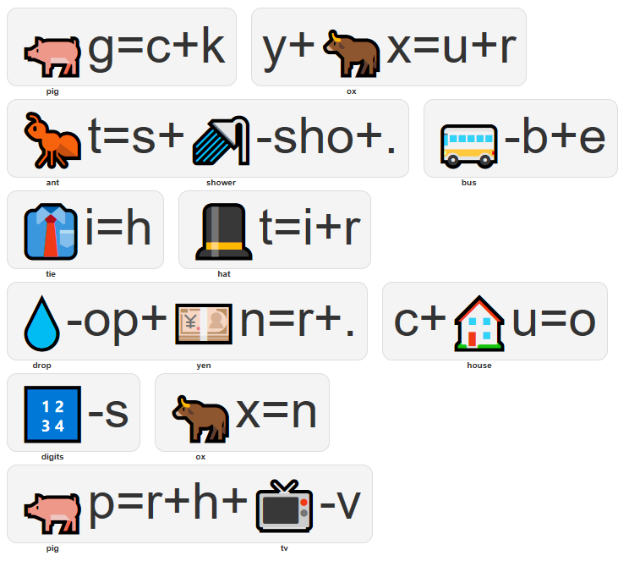
2 sets this page. Rebus reads: “Pick your answer. Use the hair dryer. Choose digit on right.”
Knowing what to do in an emergency is important. Read the options on each card and select the correct school policy. How do you reveal the code? Guess a little deciphering is in order!
Knowing what to do in an emergency is important. Read the options on each card and select the correct school policy. How do you reveal the code? Guess a little deciphering is in order!

Slide 17


1
Fire Drill Procedure
Students will quietly get up, wait for the teacher’s instruction to leave, and follow the designated route out of the building.
8 9
Instruction will stop. Students will move to one centralized location and updates will be given periodically.
6 7
Instruction continues as normal, and announcements will be made to update the situation.
3 4
2
Lock Down Procedure
Students will run to the nearest exit to get out of the building.
0 1
Instruction continues as normal, but the doors should remain locked and all windows closed. Announcements will be made to update the situation.
4 5
Students will quietly get up and move to a designated area within the classroom. Students will remain silent until released by the teacher.
2 3
B2S: Puzzle 3

Slide 18

3
Severe Weather Procedure
Instruction continues as normal, and announcements will be made to update the situation.
3 4
Students will quietly move to the designated area as instructed by the teacher.
6 7
Instruction will stop, and students will move closest to the windows. Updates will be given periodically.
1 2
B2S: Puzzle 3

Slide 19

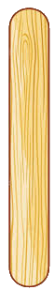




You can print and cut apart these popsicle sticks or use actual wooden sticks and write the clue on with a sharpie. Include the shape.
U S E Y O U R
S Y L L A B U S
T O F I N D
T H E I N F O
S H O W T H E
T E A C H E R
B2S: Puzzle 4

Slide 20
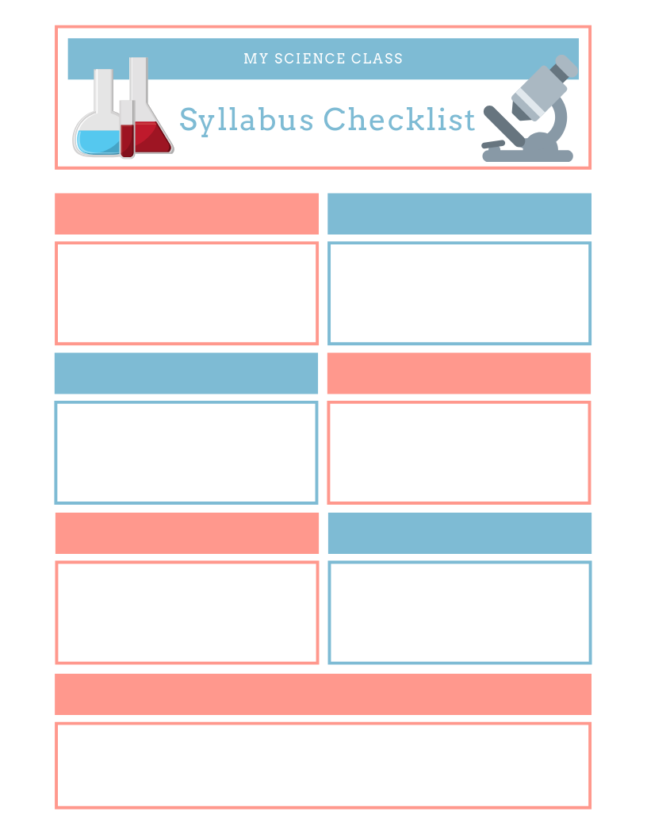
What should you do when you enter the classroom?
What are the food, drink, and gum policies?
What is the late policy?
What are the make-up work and late work policies?
If you finish early, what should you do?
What is the bathroom policy?
How is your grade calculated for this class?
Where can I find class resources?
B2S: Puzzle 4

Slide 21
Customize this syllabus to meet your needs
What rules/policies are important to you?
Question 3
Question 4
Question 5
Question 6
Question 7
B2S: Puzzle 4

Slide 22

Print on card stock for best results.
B2S: Puzzle 5

Slide 23
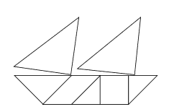
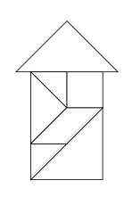

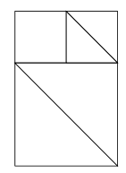
The directions make. . . .
The directions make. . . .
5778
8471
The directions make. . . .
The directions make. . . .
5647
6578
The directions make. . . .
The directions make. . . .
7844
1245
B2S: Puzzle 5

Slide 24


I can . . .
Follow Directions
Following directions is so important! The order of the steps and diagrams and discussing thing with teammates can help you be successful. Can you follow these directions to find the code?
Hypotenuse
Gather your 7 shapes.
Find the medium triangle. Place the triangle flat on the desk with the point of the triangle facing down and the hypotenuse facing up.
Get the parallelogram and place it to the right of the triangle. Connect one of the longer sides of the parallelogram to the right side of the triangle. The tops of the two shapes should be even on top and form a flat line.
Find a small triangle and slide it to the right of the parallelogram. There is a space to the right of the parallelogram where the hypotenuse of the triangle will match up with the slanted edge of the parallelogram.
Place the square to the right of the small triangle. At this point, all the top and bottom edges should line up and form straight lines.
The last shape in the row is going to be the other small triangle. Place a short side of the triangle along the right side of the square so that the hypotenuse is pointed down and to the right. The other short side of the triangle should continue the line along the top of the other shapes.
Take one of the big triangles and place it above the medium triangle you placed first. Turn the triangle so the corner with the right angle is touching where the medium triangle and the parallelogram meet up. Shift the big triangle to angle the hypotenuse up just a bit more.
Take the other big triangle and place it above the square. Turn the triangle so the corner with the right angle is touching where the square and end triangle meet up. Shift the big triangle to angle the hypotenuse up just a bit more.
What did you build? Match it to one of the pictures to get the code.
B2S: Puzzle 5

Slide 25
TEACHER | CAN | CLUE | FIGURE | CODE | SECRET
GET | YOU | STRING | DISAPPEAR | HEAT | OLIVE
MOUSE | TEAM | WORK | TABLET | GOOGLE | PASS
NUMBER | CLUE | CODE | CAN’T | PUG | WORDS
DOG | TIRED | THE | DOMINO | IS | EMAIL
PHONE | DUMP | LOOK | IT | UP | BUT
WINDOW | DESK | KEY | CEILING | BUILD | CHAIRS
STRING | PARTNER | ANGRY | GROWTH | PLATE | CUP
GIRAFFE | ONIONS | THE | MICRO | SLIDES | WORD
SOME | THING | SECRET | TO | WHISPER | SLEEP
CUPS | MAGNET | CLUE | SLEEPING | IS | YOURS
RUG | DUDE | GET | ITS | FROM | TWENTY
TAPE | AT | KING | THE | ORANGE | BOTTOM
THE | CAT | MINE | BEAUTY | CHEWING | ABOVE
STAPLER | ELEVEN | BACK | PHONE | GUM | OF
PEANUTS | KOALA | WINDOW | CLUE | OUT | PASS
THE | HINT | BOX | IT | YOUR | IS
K’NEX | LEAK | DOOR | RED | GLUE | BATH
ASSEMBLE | PURPLE | MAGNETIC | BELOW | STUDENT | TEACHER
B2S: Puzzle 6

Slide 26
Overlay 1
You can prepare the overlays in one of three ways:
Print it on a transparency so that the words are clearly visible when laid on top of the word grid.
Print and then cut out the boxes with a paper knife and laminate the paper.
Print it on regular paper and tape to a window or hold over a light. The white boxes will allow the text to show through when stacked with the word grid.
B2S: Puzzle 6

Slide 27
THE
Overlay 2
B2S: Puzzle 6

Slide 28
Overlay 3
B2S: Puzzle 6

Slide 29
Overlay 4
B2S: Puzzle 6

Slide 30

Teamwork is so important.
Can you figure out how to get the clue without moving the container?
Teamwork is so important.
Can you figure out how to get the clue without moving the container?
Teamwork is so important.
Can you figure out how to get the clue without moving the container?
Teamwork is so important.
Can you figure out how to get the clue without moving the container?
845
845
845
845
4 sets this page. Secure a paper clip to the code to make it magnetic.
B2S: Puzzle 6

Slide 31

B2S: Puzzle 7

Slide 32

Cut out each row and fold them so they are double-sided. The fixed mindset is on one side and growth mindset on the other.
I got it wrong.
2
I can learn from
my mistakes.
3
I can learn
new things.
4
I’ll never be
that smart.
14
I give up.
9
I’ll try a different
strategy.
11
This is good enough.
12
Is this my best work?
5
This may take
some time.
7
This is too hard.
6
B2S: Puzzle 7

Slide 33
Cut out each row and fold them so they are double-sided. The fixed mindset is on one side and growth mindset on the other.
I am on the
right track.
5
I’m already
awesome at this.
9
Plan “A” didn’t work,
I give up.
19
Plan “A” didn’t work, good thing the alphabet has 25 more letters. . .on to plan “B!”
3
I can always improve, so I’ll keep trying.
1
I can’t make this any better.
7
I’m not good at science.
12
I can train my brain in Science.
2
Mistakes help me
learn.
6
I made a mistake.
4
B2S: Puzzle 7

Slide 34
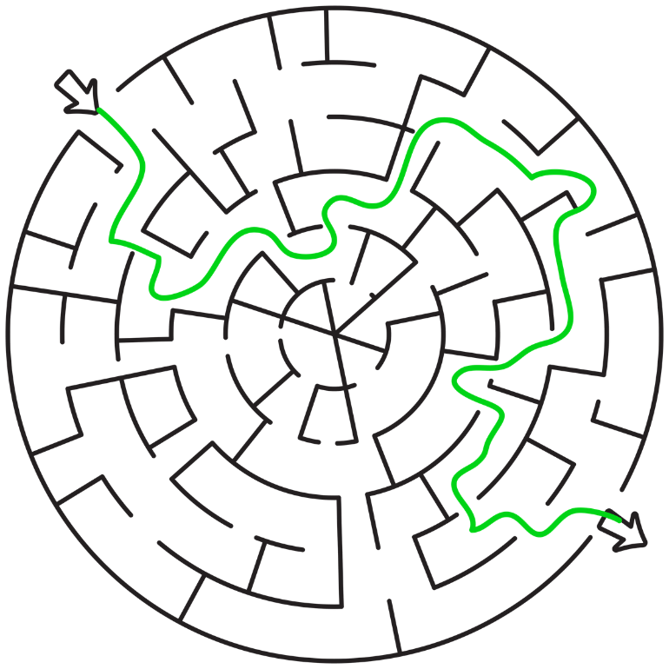

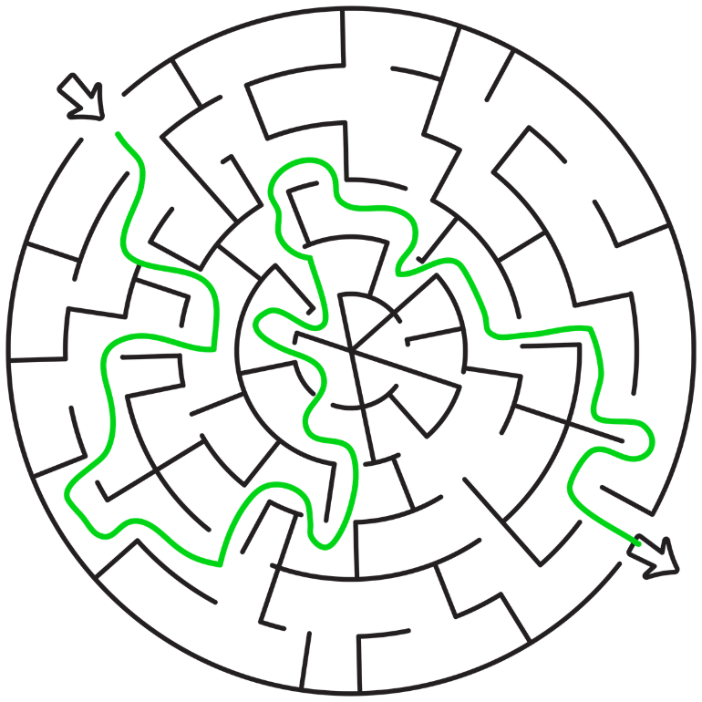

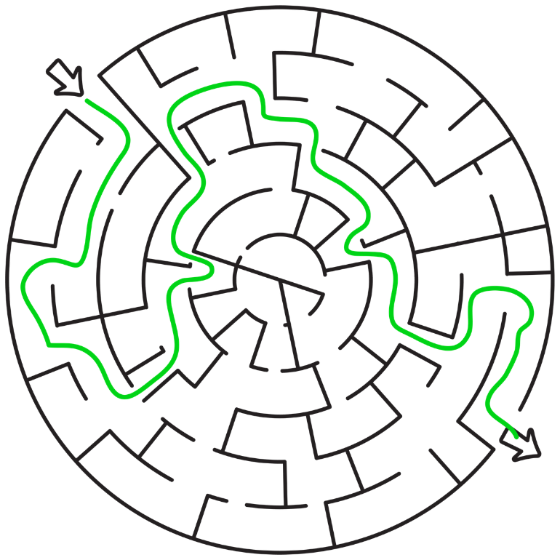

7 pencils
Answer to Mazes
10 books
8 calculators
B2S Puzzle 8

Slide 35
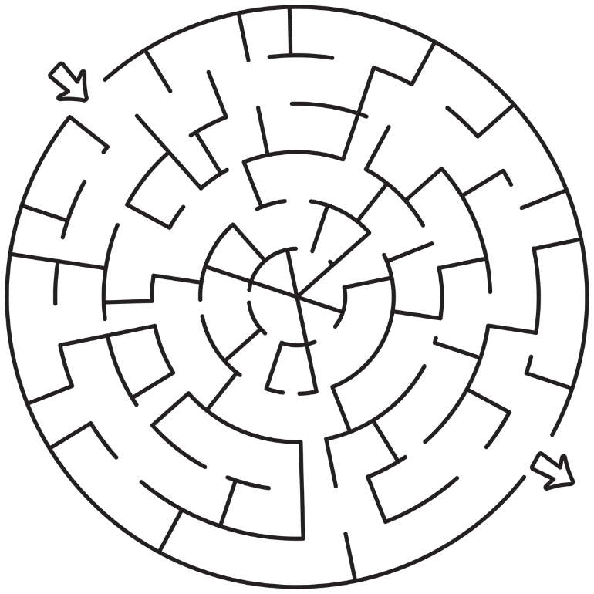
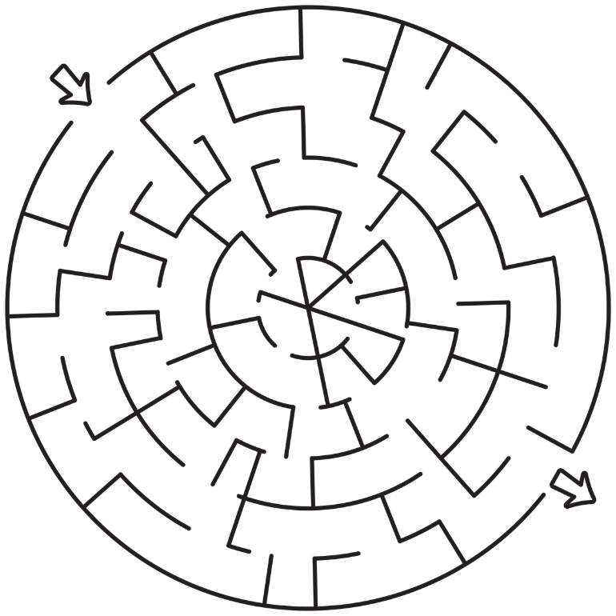
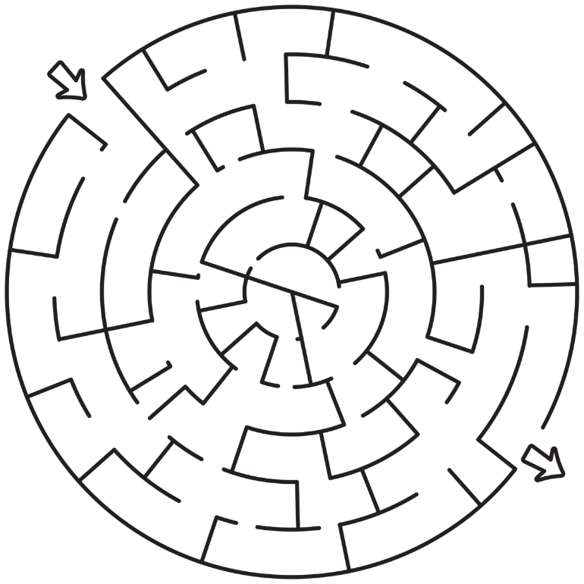
2 sets this page
B2S Puzzle 8
B2S Puzzle 8

Slide 36

Because you are such
a-MAZE-ing students, I know you’ll come to class prepared!
Get a maze from your teacher.
Find the number of pencils, calculators, and books you pick up in the maze. Then find the product of those numbers to get the secret code.
B2S Puzzle 8
Because you are such
a-MAZE-ing students, I know you’ll come to class prepared!
Get a maze from your teacher.
Find the number of pencils, calculators, and books you pick up in the maze. Then find the product of those numbers to get the secret code.
2 sets this page
B2S Puzzle 8

Slide 37
Prize Ideas
The lists below are ideas you could use for prizes if the group escapes all of the challenges.
Pencils and erasers
Free test question answer
Free Redbox rental
Takis or Hot Cheetos
Free coupon for a local establishment like Sonic or DQ
Lunch with the teacher
Lunch in the classroom
Homework pass
Front of the lunch line pass
Free tardy pass
Bonus points
Gum passes
Technology pass
Drop the lowest grade
Stickers
Dollar Tree trinkets
Choose your own seat
Sit in the teacher’s chair
Medals
Pizza
Headphones for the day
Pop sockets
Coke and a smile
Spin a wheel
Gift cards
Keychains
Take your shoes off pass
Posted picture on website
Deadline extension pass
Pick the class music
Picture on the wall
Bring a blanket pass
Teacher assistant pass
Feed the animal pass
Pick the next review game
Restroom pass
Lunch outside
Sit next to a friend pass
Winner ribbons
Extra clue for the next escape room
Let them present the next demo
Brag tags
Candy (obviously)
Leave class 2 mins early
School supplies
Wear a hat
School “cash” or ”points”
Plastic trophy
Escape room winner wall
Picture posted to social media
Computer time
Teacher for 10 – 10 mins of being the teacher
Popcorn party
3D printing of their choice
Lab coat for the day
Use notes on quiz
Game master – allow students to help setup the next game
A pat on the back
Allow students to charge their phone
T-shirt or mug
Index card for an exam
Get creative

Slide 38

Editable Reward Templates
This coupon entitles you to <insert your reward and center the text>
This coupon entitles you to <insert your reward and center the text>
This coupon entitles you to <insert your reward and center the text>
This coupon entitles you to <insert your reward and center the text>
This coupon entitles you to <insert your reward and center the text>
This coupon entitles you to <insert your reward and center the text>

Slide 39
Science Escape Social Sharing
What Now?:
Escaping all of the challenges is only part of the fun. The other part is being able to brag about it to your friends.
I have included a series of signs to be used to photograph the group after they have escaped or not. Allow the students to choose the signs that best represents them. I’ve also included templates which allow you to create your own creative signs.
As a fun option, students who complete or participate in the escape room could receive a pencil to decorate with colored duct tape or washi tape and keep in the classroom so that they are always prepared for class with their own customized pencil.
Encourage Sharing:
I will be monitoring the hashtags #keslerscience and #scienceescape on Twitter and Instagram. I look forward to interacting with everyone there ☺
Be careful to when sharing student faces and please refer to your district policy regarding this issue.

Slide 40

Einstein has NOTHING on me!

Slide 41
Mom said I was gifted.

Slide 42
WE
ESCAPED!

Slide 43
Science Escape King

Slide 44
Science Escape Queen

Slide 45
I’m a Brainiac

Slide 46
Pure Genius

Slide 47
Master of my Domain

Slide 48
Crushed
It!

Slide 49
Neil deGrasse
Who?

Slide 50
I’m Too Smart For This

Slide 51
Nailed
It

Slide 52
MASTER

Slide 53
Smarty
Pants

Slide 54
Create Your Own
See separate file in the download.

Slide 55
SOOOOOO
Close!!

Slide 56
Epic
Fail!

Slide 57
Brain
Freeze

Slide 58
Almost

Slide 59
Next
Time

Slide 60
What am I Even Doing Here?

Slide 61
I Had No Contribution

Slide 62
ALMOST
Doesn’t Count

Slide 63
FAIL

Slide 64
I Hope This Isn’t A Reflection Of My Grade

Slide 65
There’s A Test Tomorrow?

Slide 66
I Don’t Get It!

Slide 67
Help
Us

Slide 68
Ummmm.

Slide 69
I Like Stuff

Slide 70
Create Your Own
See separate file in the download.

